Slide 1


Slide 2
Interprocess Communication
Inter-process communication (IPC) is a set of methods for the exchange of data among multiple threads in one or more processes.
Processes may be running on one or more computers connected by a network.
Operating systems provide facilities/resources for inter-process communications (IPC), such as message queues, semaphores, and shared memory.

Slide 3
Interprocess Communication Methods
Inter-process communication techniques can be divided into various types. These are:
1. Pipes
2. FIFO (Named Pipes)
3. Shared memory
4. Message Passing / Message Queue
5. Sockets

Slide 4
Interprocess Communication Methods
1. Shared memory: Shared memory is an efficient means of passing data between programs.
An area is created in memory by a process, which is accessible by another process.
Processes communicate by reading and writing to that memory space.

Slide 5
Shared Memory
Also known as Direct Communication
Processes must name each other explicitly:
send (P, message) – send a message to process P
receive(Q, message) – receive a message from process Q
Properties of communication link:
A link is associated with exactly one pair of communicating processes
Between each pair there exists exactly one link
The link may be unidirectional, but is usually bi-directional

Slide 6
Interprocess Communication Methods
2. Message queues: By using this method, a developer can pass messages via a single queue or a number of message queues.
A system kernel manages this mechanism.

Slide 7
Message Passing
Also known as In-direct Communication
Messages are directed and received from mailboxes (a common message queue)
Each mailbox has a unique id
Processes can communicate only if they share a mailbox
Properties of communication link
Link established only if processes share a common mailbox
A link may be associated with many processes
Link may be unidirectional or bi-directional

Slide 8
IPC: Message Passing
Operations
create a new mailbox
send and receive messages through mailbox
destroy a mailbox
Operations/ Primitives are defined as:
send(mailbox, message) – send message to mail box
receive(mailbox, message) – mailbox receives message.

Slide 9
IPC: Message Passing
Example:
Producer-Consumer Problem :Paradigm for cooperating processes
Producer process produces information that is consumed by a consumer process
– unbounded-buffer: places no practical limit on the size of the buffer
– bounded-buffer: assumes that there is a fixed buffer size

Slide 10
IPC: Message Passing Synchronization
• Message passing may be either:
Blocking
Non-blocking
1. Blocking is considered synchronous:
Blocking send: has the sender block until the message is received
Blocking receive: has the receiver block until a message is available

Slide 11
IPC: Message Passing Synchronization
2. Non-blocking is considered asynchronous:
Non-blocking send: has the sender send the message and continue
Non-blocking receive: has the receiver receive a valid message or null

Slide 12
Interprocess Communication Methods
3. Sockets: This mechanism is used to communicate over a network, between a client and a server.
This method facilitates a standard connection that is independent of the type of computer and the type of operating system used.

Slide 13
Communication in Client-Server Systems
Sockets
Defined as end point of communication
Pair of processes communicate over the network user sockets- one socket for each process
Socket is identified by an IP address which is concatenated with port number
Server listen to client via a port, server receives the request and complete the connection.

Slide 14
Communication in Client-Server Systems
Sockets
It created using socket() system call.
It takes:
  Communication Domain
  Socket type
  Protocol to be used: as argument

Slide 15
Interprocess Communication Methods
4. FIFO: A FIFO or 'first in, first out' is a one-way flow of data.
FIFOs are similar to pipes
FIFOs are identified in the file system with a name.
FIFOs are 'named pipes.

Slide 16
Pipe
A pipe is a communication channel between two ends. It is mostly used to communicate between processes running within a computer.
It is used on the command line to direct the output of a command as input of the next command.
A pipe is created by a process, that process calls fork, and the pipe is used between the parent and the child.

Slide 17
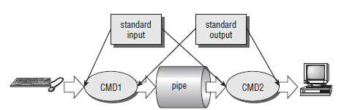
Pipe
For shell commands, this is done using the pipe character to join the commands, such as cmd1 | cmd2.

Slide 18
Pipe
Pipes have two limitations.
They have been half duplex (i.e., data flows in only one direction).
Pipes can be used only between processes that have a common ancestor (parent).

Slide 19
Pipe
Pipe() is a system call that facilitates inter-process communication.
Pipe opens a virtual file, which is used for communication between parent and child.
One process can write to this "virtual file" or pipe and another related process can read from it.

Slide 20
Types of Pipe
Unnamed
  Virtual file used to send data between 2 processes.
  Unnamed pipe can only work with related process.
Named or FIFO
  Created by using mkfifo command
  It is a permanent file.
  FIFO is same to unnamed file but with a facility that it can be accessed from anywhere.

Slide 21
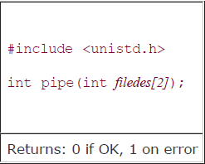
Interprocess Communication
Syntax :

Slide 22
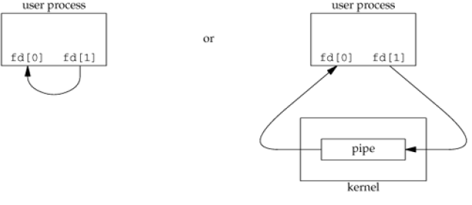
Interprocess Communication
Two file descriptors are returned through the fileds argument: fd[0] is open for reading, and fd[1] is open for writing.
The output of filedes[1] is the input for filedes[0].

Slide 23
Example
fd[0] - the read end of the pipe - is a file descriptor used to read from the pipe
fd[1] - the write end of the pipe - is a file descriptor used to write to the pipe

Slide 24

Popen and pclose
The simplest way of passing data between two programs is with the popen and pclose functions.
The popen function allows a program to invoke another program as a new process and either pass data to it or receive data from it.
The command string is the name of the program to run, together with any parameters. open_mode must be either “r” or “w”.

Slide 25
Popen and pclose
popen :
Arguments :
1. command that will be executed by the child process.
2. The type of communication by the parent, i.e. whether the parent is going to read from the pipe or write into the pipe.
Return : It returns a file descriptor that gets created as a result of call to the pipe.
rd=popen("ls","r");

Slide 26
Un-named Pipe with popen() and pclose()
1. Write into a pipe
Syntax: File pointer = popen(“process”, “mode”);
rd=popen("wc -c","w");
fwrite(buffer,sizeof(char),strlen(buffer),rd);
2. Read from file
rd=popen("ls","r");
fread(buffer, 1, 50, rd);
3. Close file after reading or writing
pclose(rd);

Slide 27
FIFOs (Named Pipes)
One of the major disadvantage of pipes is that the they can not be accessed using their names by any other process other than child and the parent.
The work around for this problem is to create a named pipe which is also called as a FIFO, which stands for First in First out, meaning the data that is written into the pipe first will be read out first always.
fifo are created using the function mkfifo()

Slide 28
Named Pipe
1. Create a file
  int res;
  res = mkfifo("fifo1",0777);
  2. Write into named pipe
res=open("fifo1",O_WRONLY);
write(res,"written",7);
3. Read from a named pipe
res=open("fifo1",O_RDONLY);
n=read(res,buffer,100);

Slide 29
MCQ
What is Interprocess communication?
a) allows processes to communicate and synchronize their actions when using the same address space
b) allows processes to communicate and synchronize their actions
c) allows the processes to only synchronize their actions without communication
d) none of the mentioned
Notes:
b

Slide 30
MCQ
Message passing system allows processes to __________
a) communicate with each other without sharing the same address space
b) communicate with one another by resorting to shared data
c) share data
d) name the recipient or sender of the message
Notes:
a

Slide 31
MCQ
The link between two processes P and Q to send and receive messages is called __________
a) communication link
b) message-passing link
c) synchronization link
d) all of the mentioned
Notes:
a

